Slide 1
Zurich
Double Lock-In
Lee Jong Geon

Slide 2
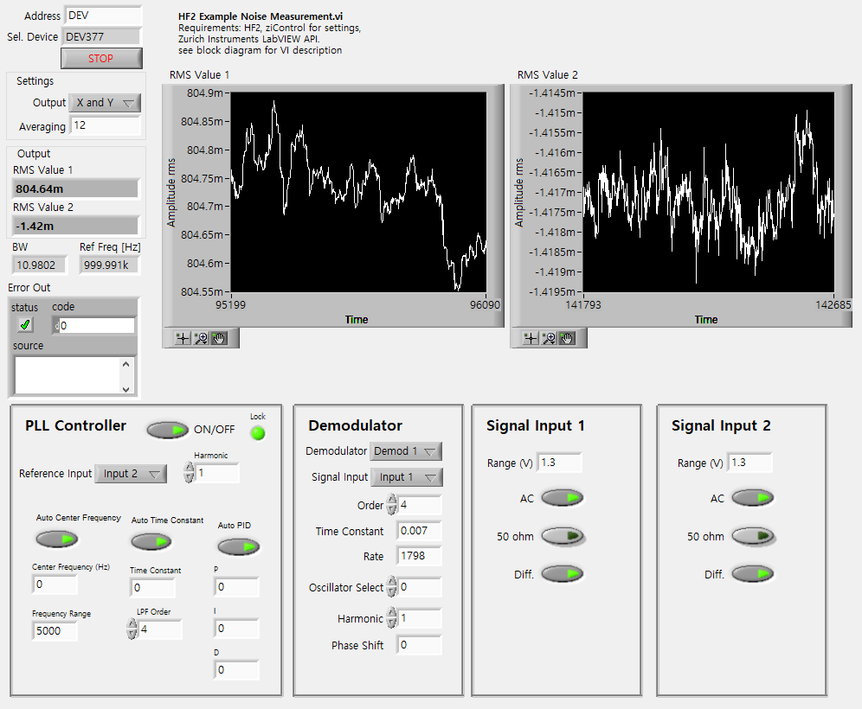
Last Points

Slide 3
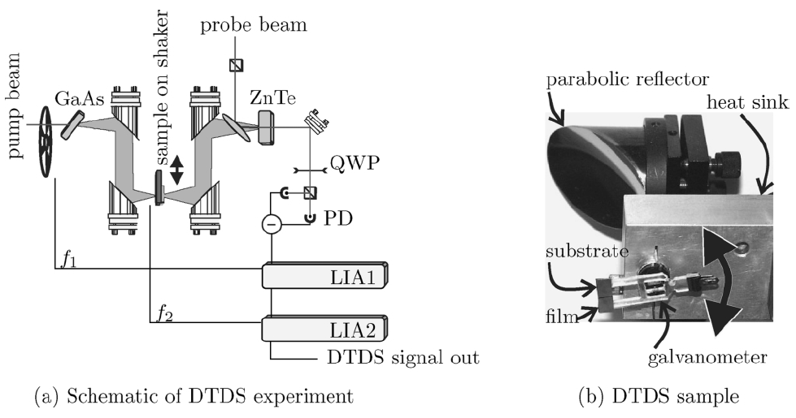
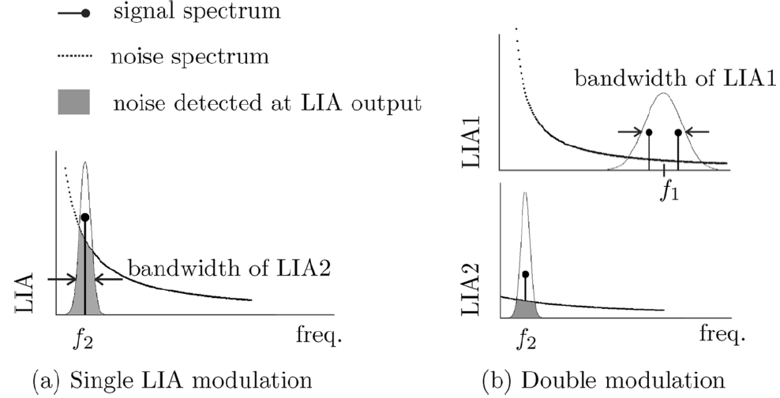
Dual Lock-In
(c)
(d)
Mickan, S. P.; Lee, K.-S.; Lu, T.-M.; Munch, J.; Abbott, D.; Zhang, X.-C. Microelectronics Journal 2002, 33 (12), 1033–1042.

Slide 4
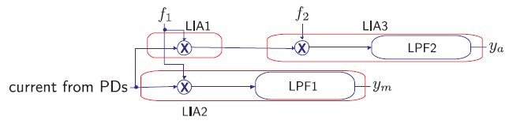
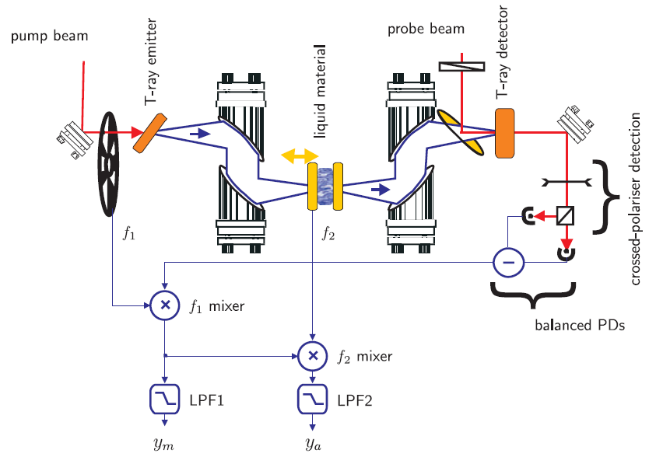
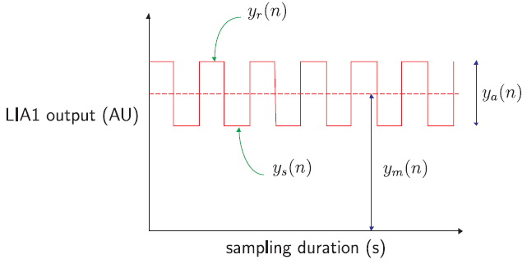
Dual Lock-In
Mickan, S. P.; Shvartsman, R.; Munch, J.; Zhang, X.-C.; Abbott, D. Journal of Optics B: Quantum and Semiclassical Optics 2004, 6 (8).

Slide 5
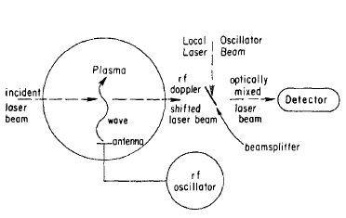
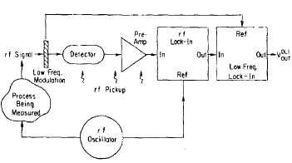
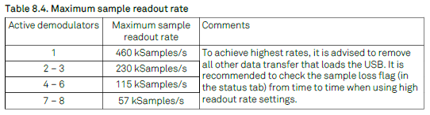
Design
Paper
Input Signal (1) + Reference Signal (2) = 3 Inputs
Input 1,2: 50MHz Bandwidth, 210MSamples/s
Aux 1, 2: 20kHz Bandwidth, 400kSamples/s
DIO 1, 2: 2MHz Bandwidth
Review of Scientific Instruments 56, 1662 (1985); doi: 10. 1063/1.1138121

Slide 6
Week Plan
 | May 5th wk. | June 1st wk. | June 2nd wk. | June 3rd wk. | June 4th wk.
PLL
Single LI Scope & Test
Dual LI Mixer Design
Dual LI Scope & Test

